Slide 1
ChatGPT Tweets
Hanning and Isabella

Slide 2
Research Ideas
Overall Topic: Changes in Public Attitude towards ChatGPT and the Factors Influencing Them
Temporal Sentiment Shift: How does the average sentiment evolve over time? Are there specific dates where a sharp shift in attitude (e.g., from novelty excitement to ethical concern) can be observed?
Topic Focus: What are the most frequently discussed topics related to ChatGPT (e.g., business impact, search engines, writing capabilities, ethics)?
Content Virality: Which content characteristics (e.g., sentiment, length, topic) are most correlated with high engagement rates (high retweets and likes)?
Influencer Impact: Do tweets posted by accounts with high Followers receive disproportionately high engagement compared to those from smaller accounts?
Engagement Lifecycle: Does the engagement rate of a tweet vary significantly depending on the time of day or day of the week it was posted?
Geographical Hotspots: Which location generates the highest volume of tweets about ChatGPT?
Regional Sentiment Differences: Is there a significant difference in the average sentiment or topic focus of tweets originating from different regions (e.g., Europe vs. the Middle East)?
Activity Peaks: On which specific dates did the overall volume of discussion peak, and what external events might explain those peaks?
Notes:
annie

Slide 3
Potential Methods
Running Sentiment Analysis
Maybe we can calculate a sentiment score (e.g., VADER, or a fine-tuned LLM/pre-trained model) and classify it.
Then we can Calculate the rate of interaction relative to the potential audience.
Finally we can Create categorical tiers for followers and engagement.
Temporal Sentiment Shift
We can Group by date and calculate the average sentiment score. And then plot the rolling average sentiment over time to visually identify sharp shifts and relate them to external events.
We are trying to vectorize the clean text using TF-IDF or CountVectorizer, but we don’t know how to use it right now, which we need more assistant.
……
We will investigate the Content Virality, Influencer Impact, and Geographical Hotspots in the similar ways.
Notes:
annie

Slide 4
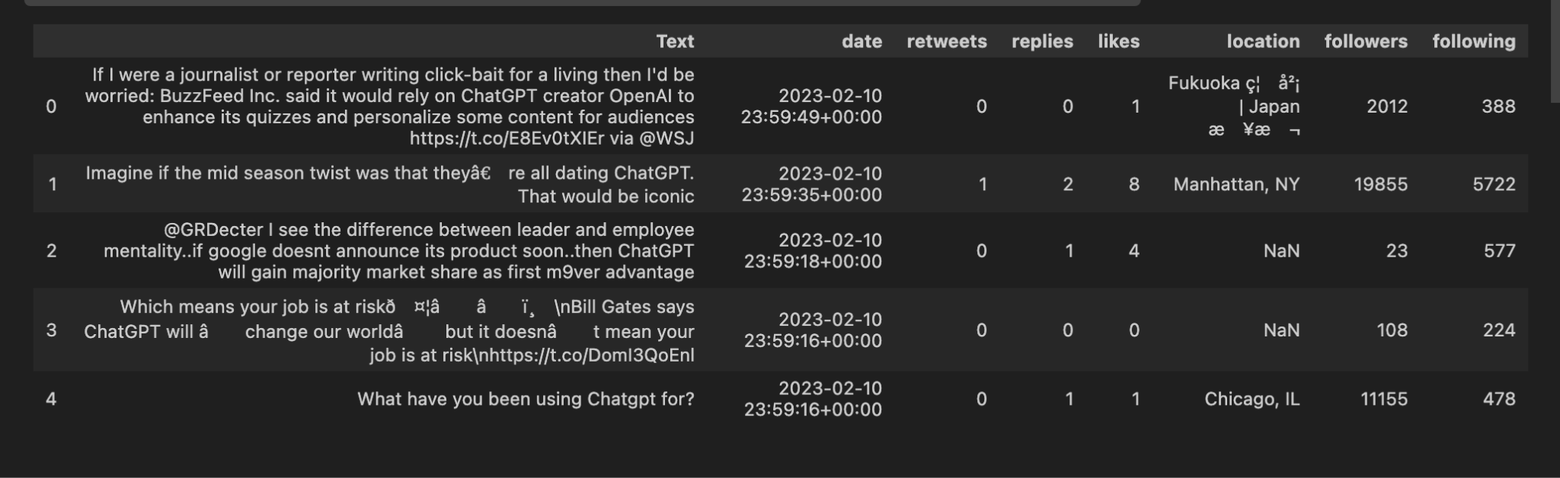
Data analysis
Notes:
isabella

Slide 5
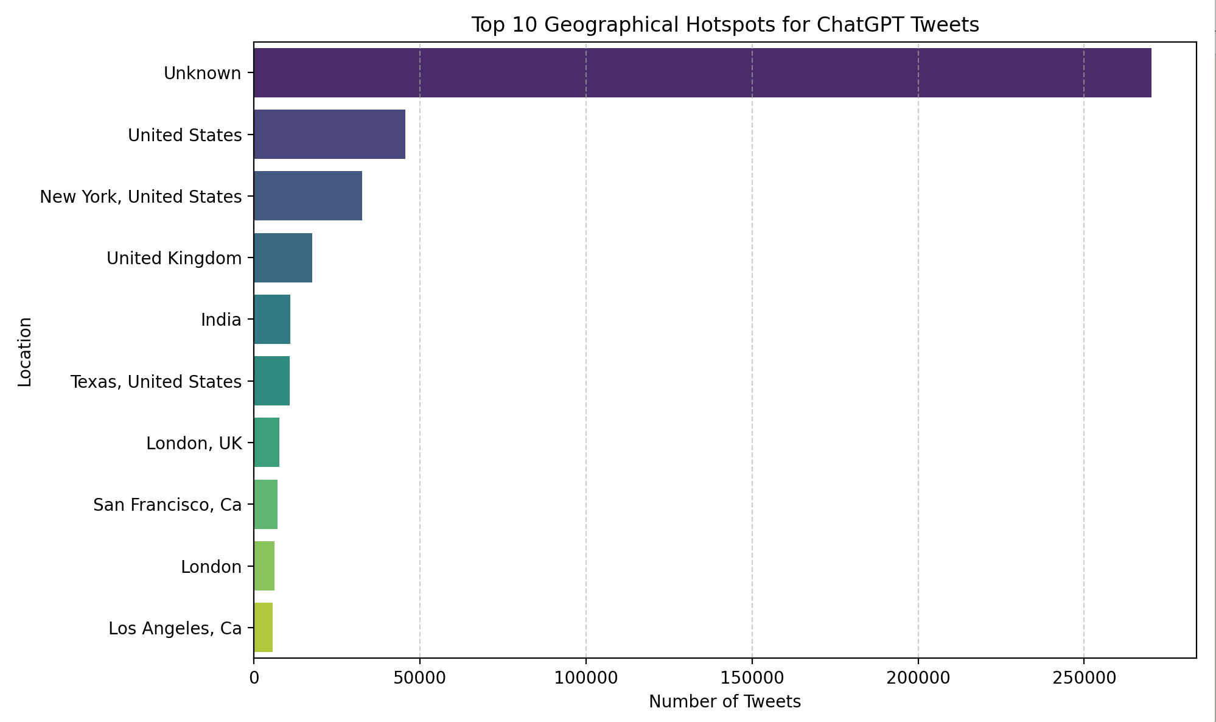
Notes:
Isabella

Slide 6
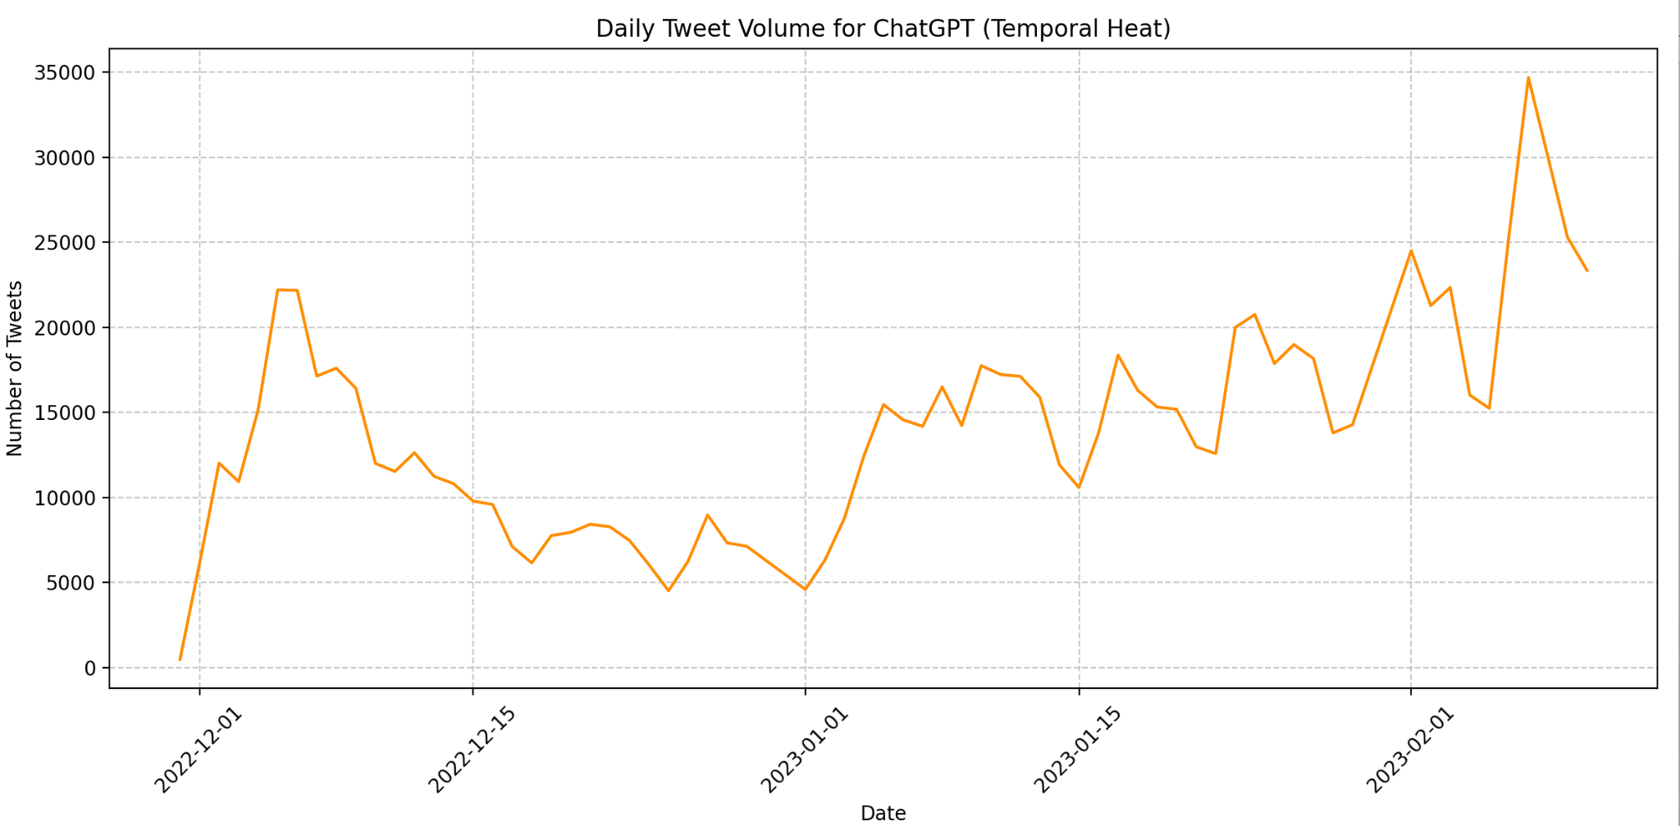
Notes:
Isabela

Slide 7
Our challenges
Missing Data
Sentiment Analysis
Cleaning Data
We have a lot of missing location data because people can input what they want.
We are interested in doing a sentiment analysis but we have never done one.
We have weird values like emojis and other characters.
Notes:
isabella

Slide 8
Plan of cooperation
Since our group only have 2 people, we plan to meet every Friday from 1-3 pm. And we will discuss every single detail together!
Notes:
annie

Slide 9

Thanks!
Please keep this slide for attribution

